Slide 1



Internship experience
Report
Amalai Rham MACHUNGA
DSA - Spring 2022
www.ultracodeltd.com.ng

Slide 2


Outline
Presentation
About Ultracode
Subject of Internship
Tool’s Architecture
Why Microsoft Fabric?
Technical Steps
Screenshots
Result
Achievements
Conclusion
Future prospects
1 of 28

Slide 3
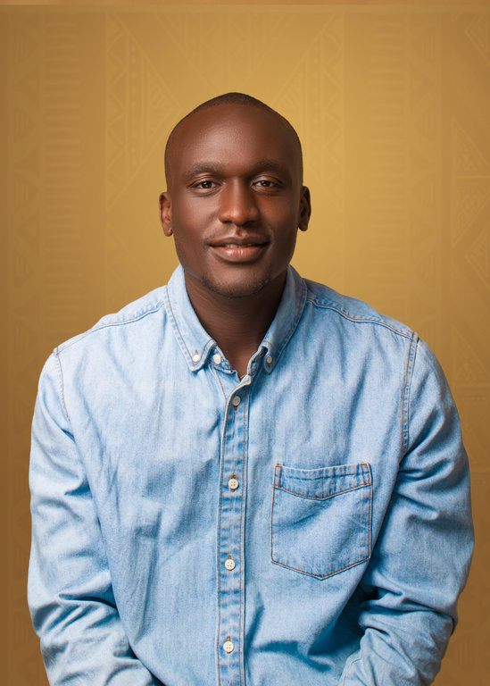
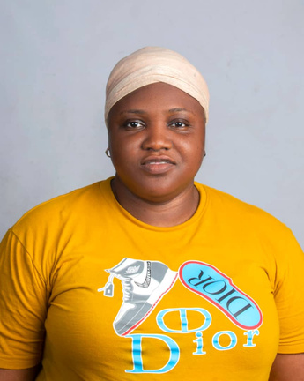
Presentation
Amalai Rham MACHUNGA
Analytics Engineer Intern, ULTRACODE
Oluwatoyin IBIYEMI
Manager and Head of Data, ULTRACODE
2 of 28

Slide 4



About Ultracode
IT outsourcing company.
Founded in 2008 by Engr. Bashir Idris.
Over 10 employees (Freelancers and Interns).
Offices in Nigeria and United Kingdom.
Completed over 100 Global Projects.
Client Domains: Governmental, health, Banking, Insurance, ICT, Education, Oil and Gas, Tourism, e-commerce, Real Estate, SME, and Stock Broking.
3 of 28

Slide 5

Subject of Internship
Development of an end-to-end data E-Commerce analytics solution and to foster a data-driven decision-making culture within the company.
4 of 28

Slide 6

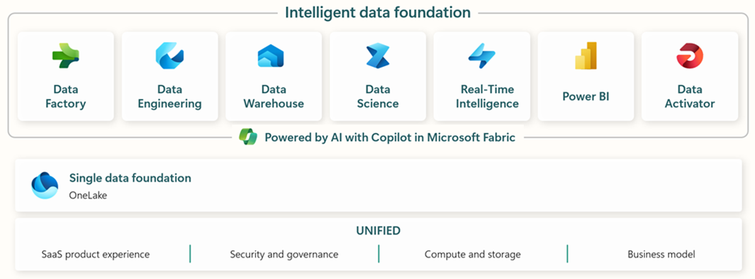
Tool’s Architecture
5 of 28

Slide 7




Why Microsoft Fabric?
Collaborative Platform
Data Security and Governance
Cost Efficiency
End-to-End Data Analytics capabilities
Technical capabilities and Knowledge
Scalability and Flexibility
6 of 28

Slide 8
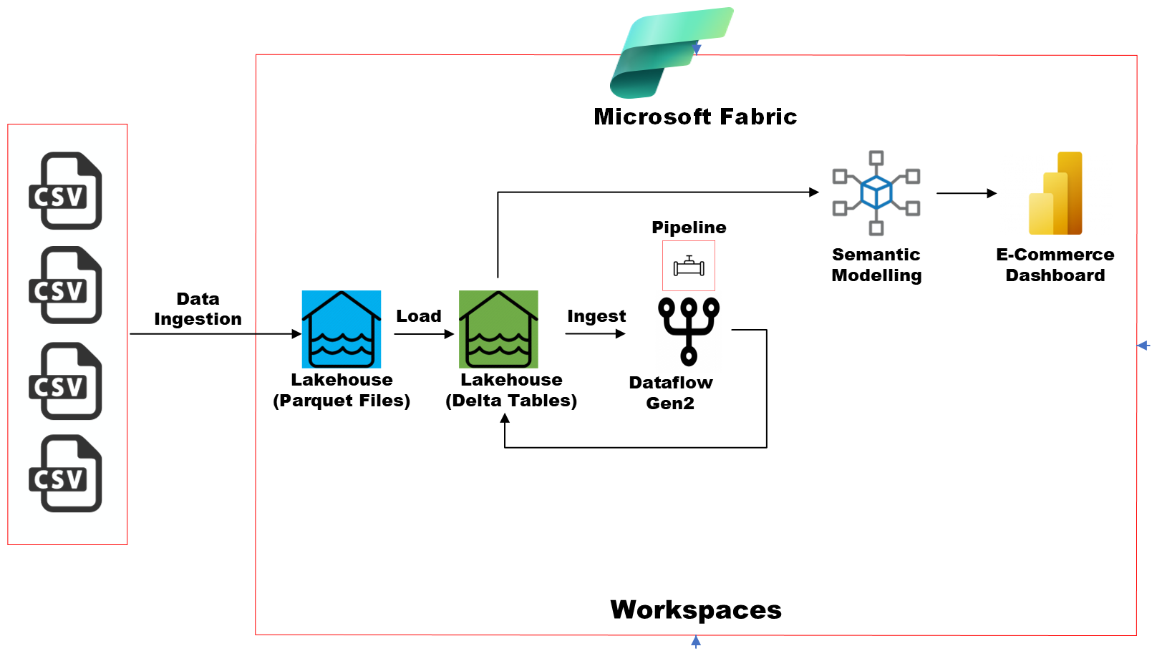
Technical Steps
7 of 28

Slide 9
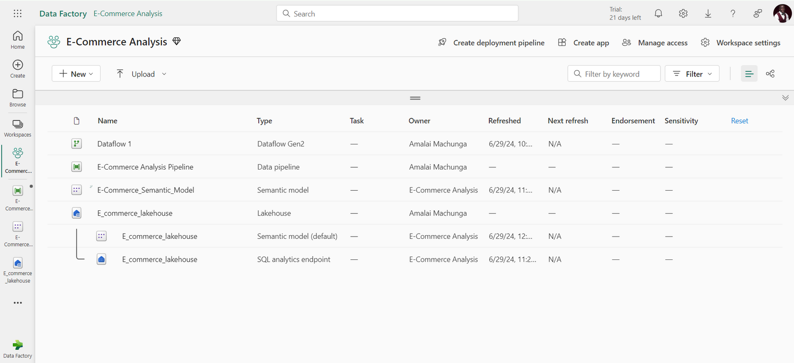
Project Workspace
8 of 28

Slide 10
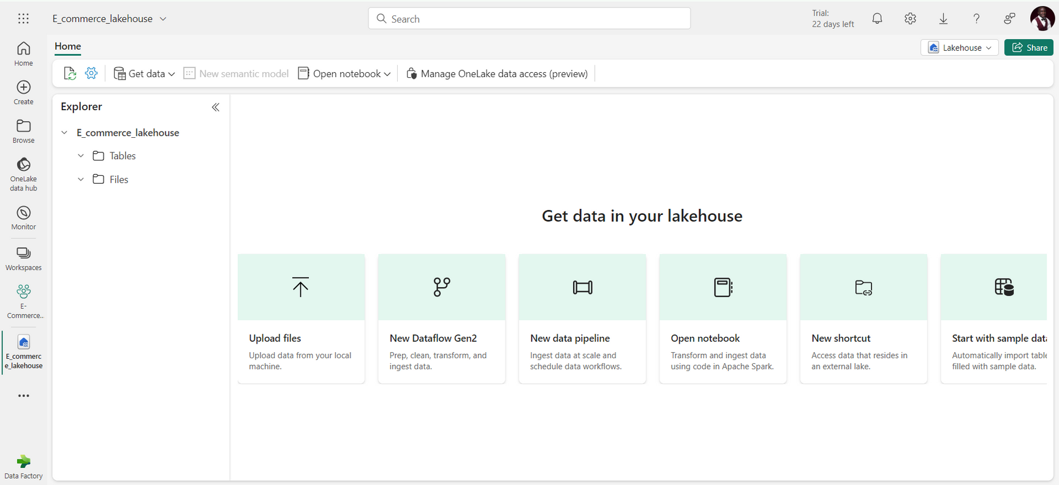
Lakehouse Creation
9 of 28

Slide 11
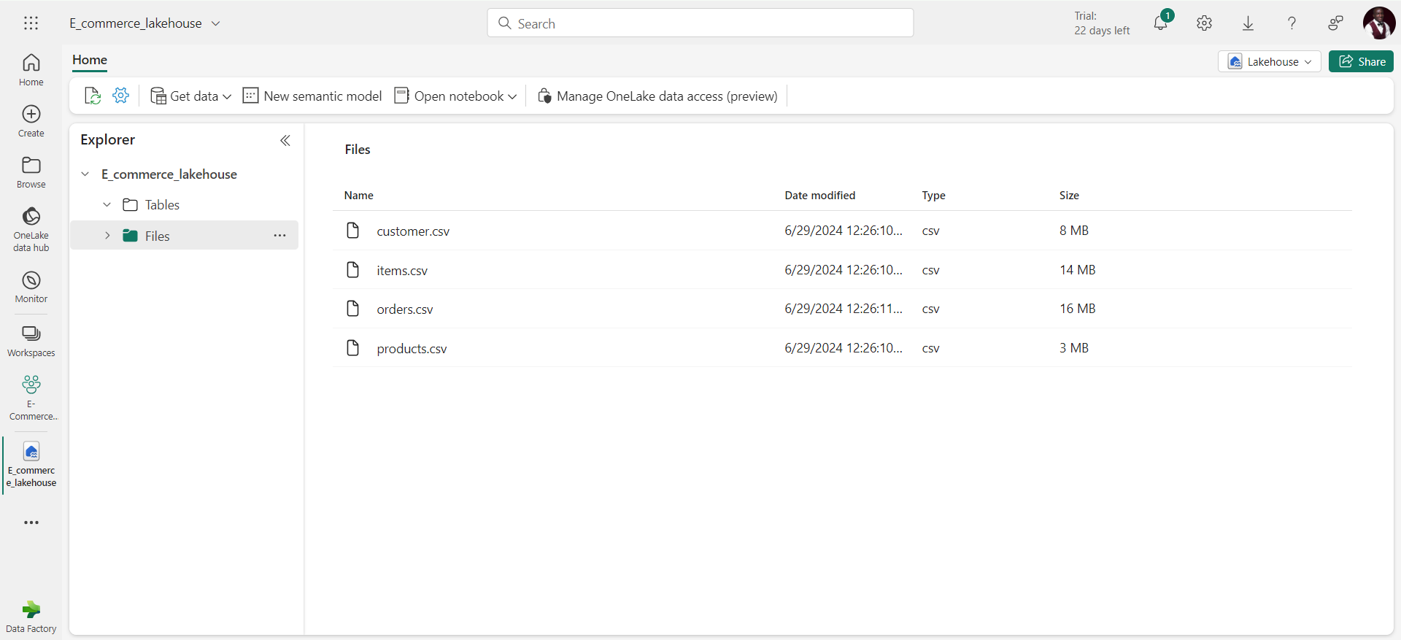
Data Ingestion
10 of 28

Slide 12
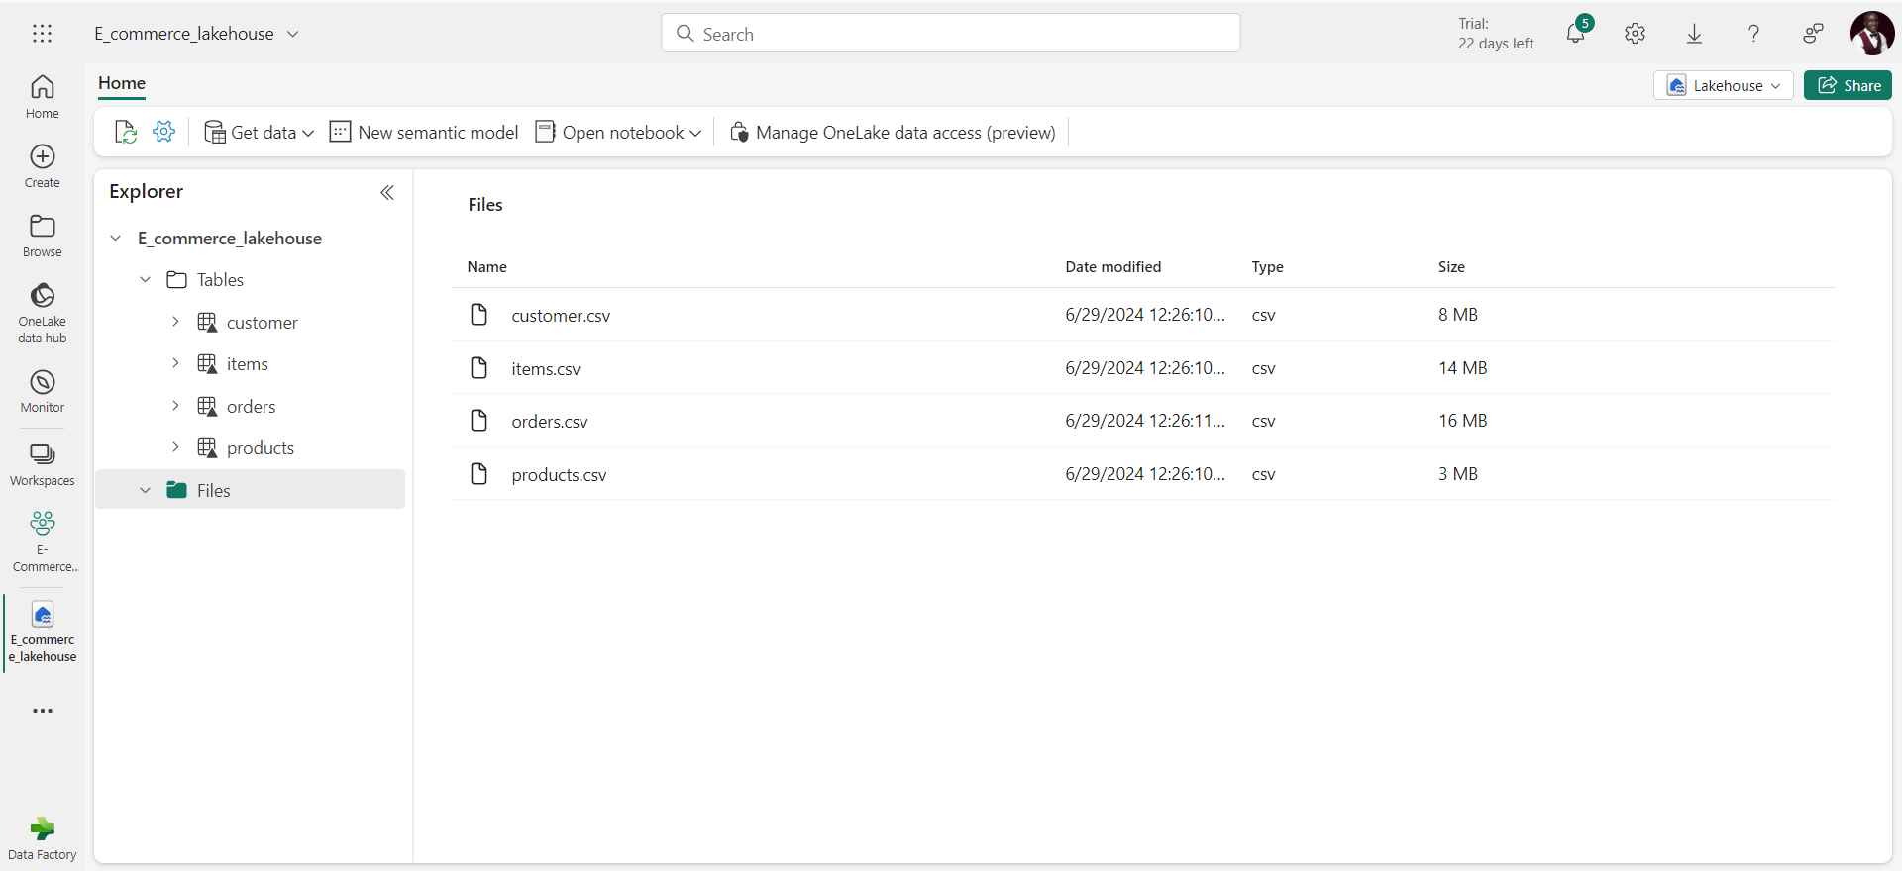
Loading to Delta Tables
11 of 28

Slide 13
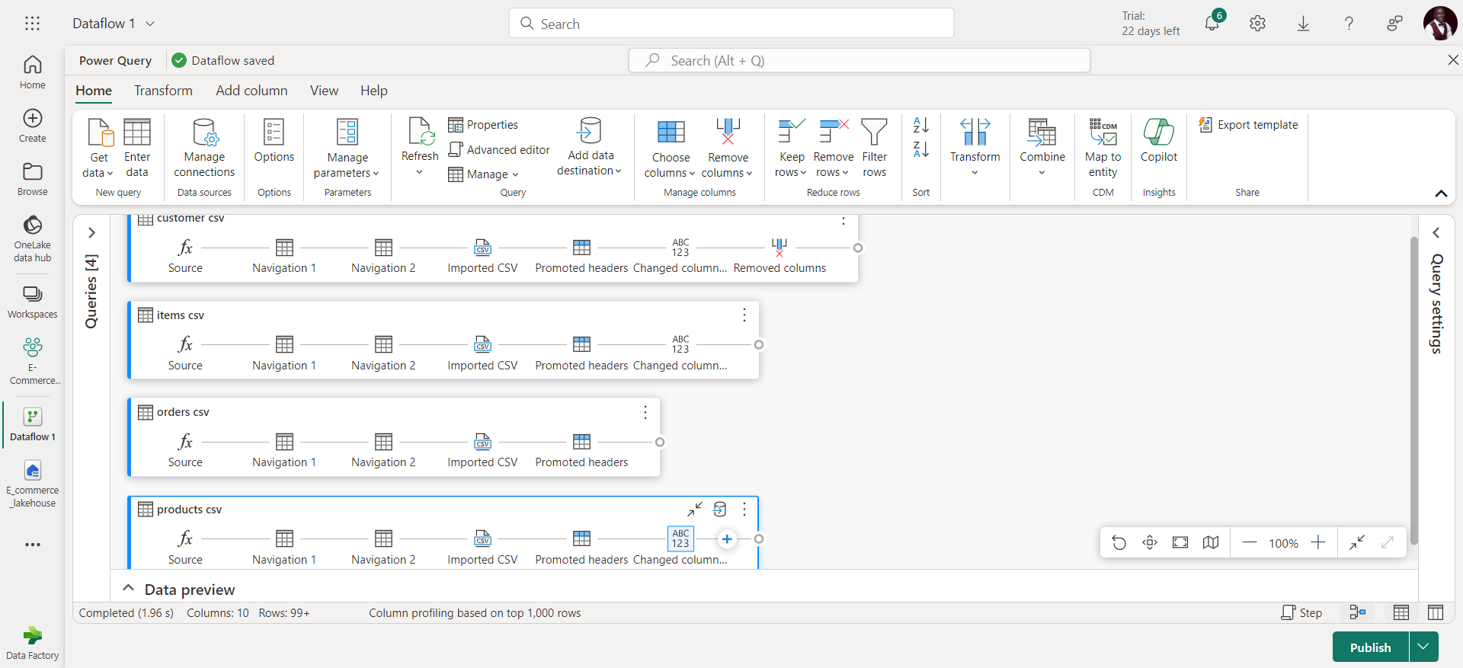
Dataflow Gen2
12 of 28

Slide 14
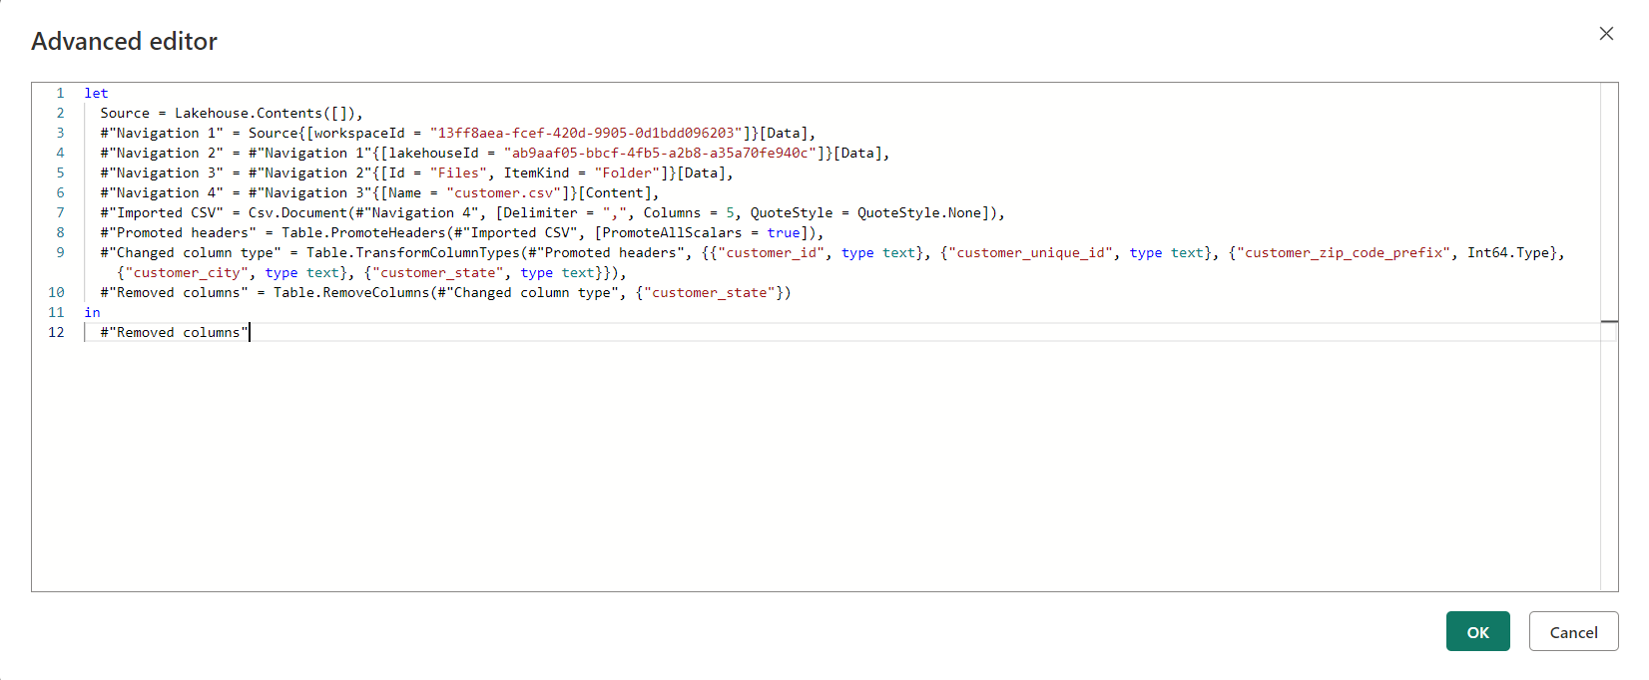
M-Language
13 of 28

Slide 15
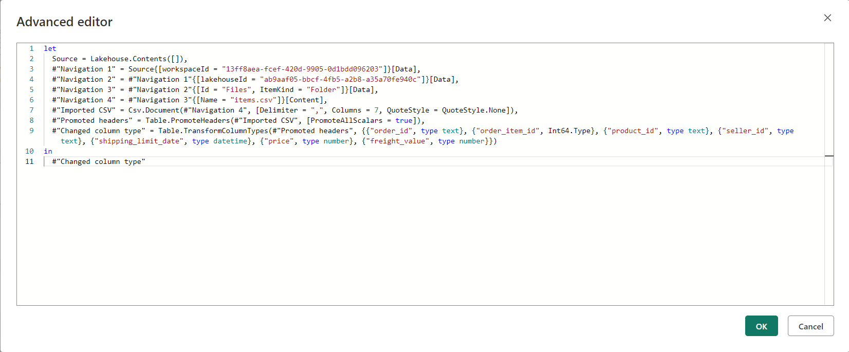
M-Language
14 of 28

Slide 16
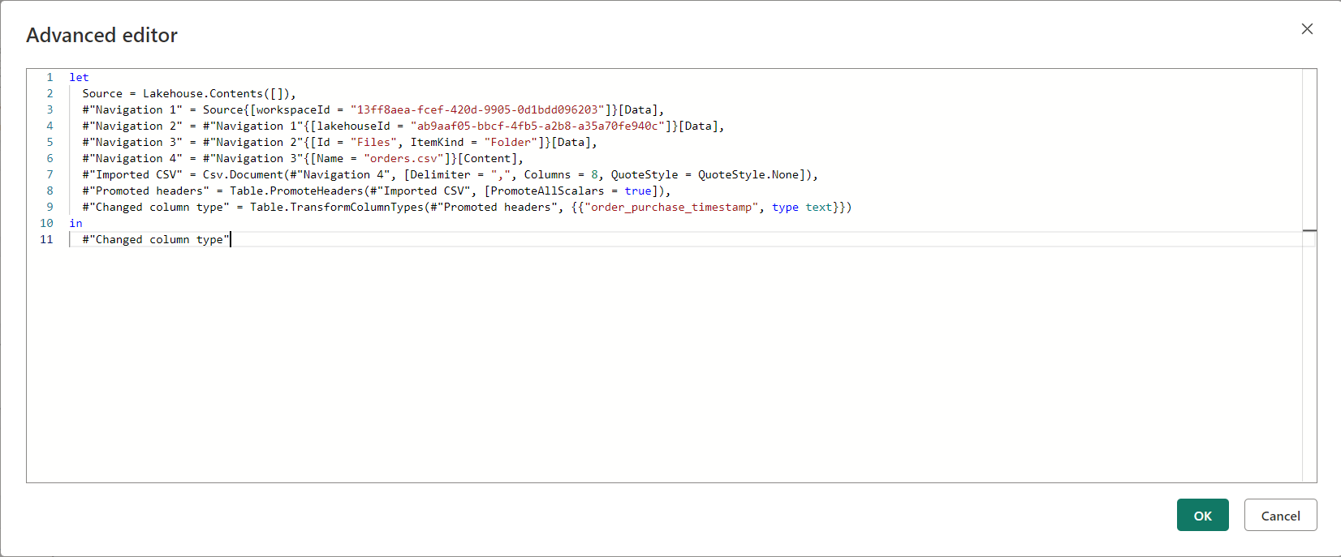
M-Language
15 of 28

Slide 17
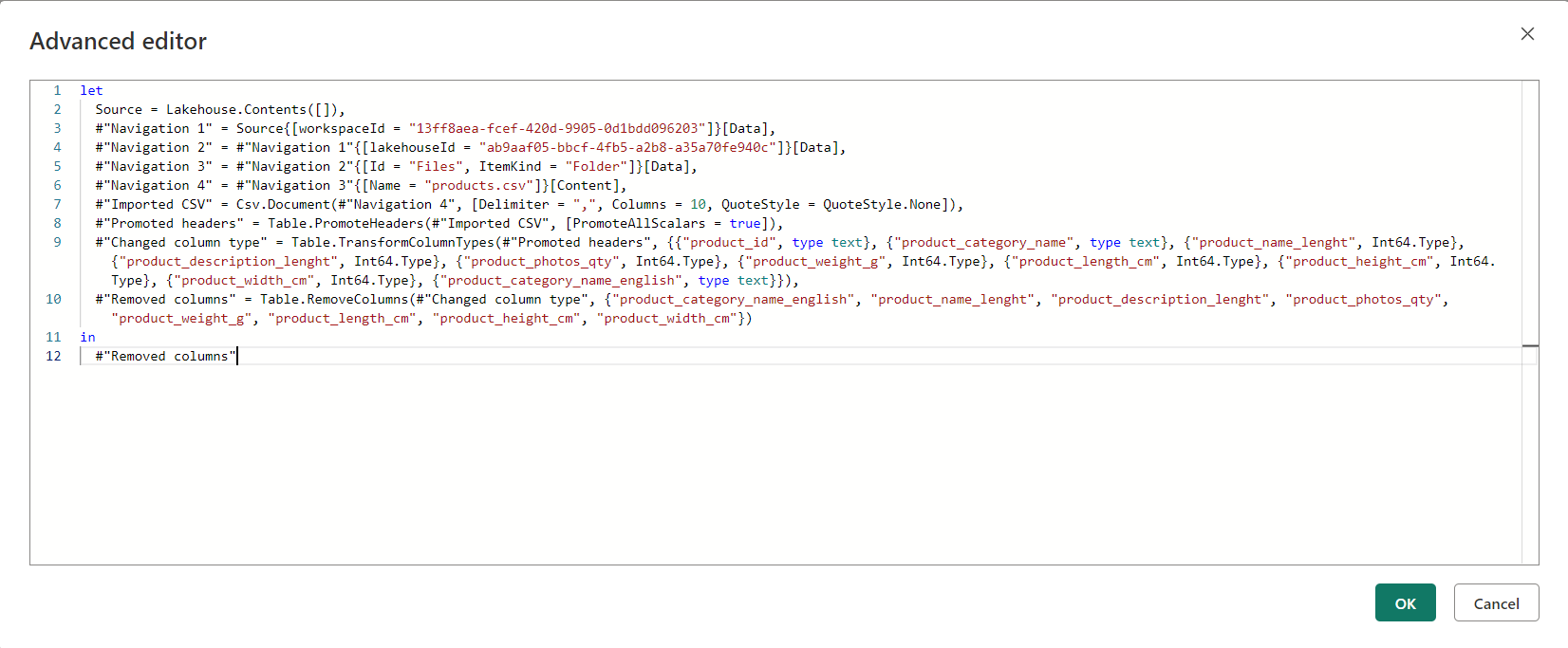
M-Language
16 of 28

Slide 18
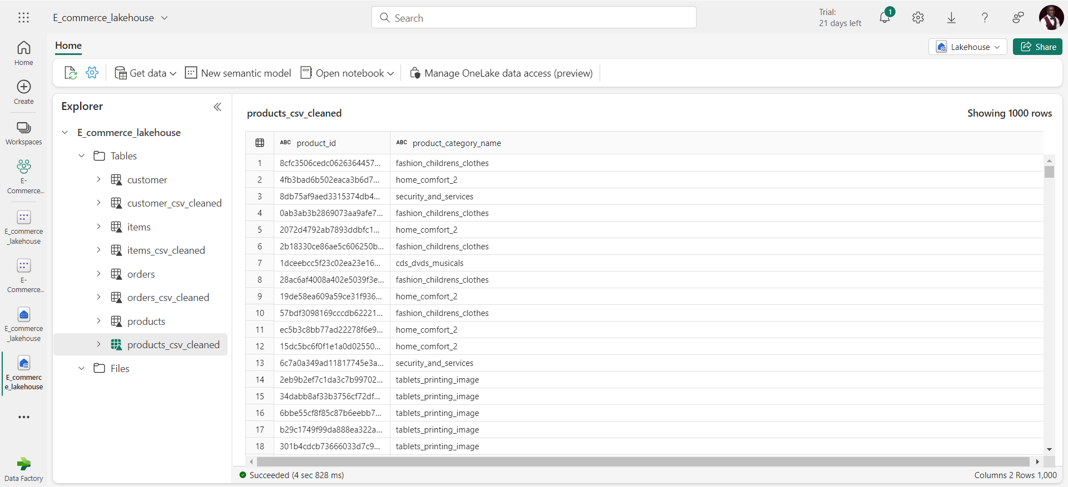
Storing Cleaned data into datalake
17 of 28

Slide 19
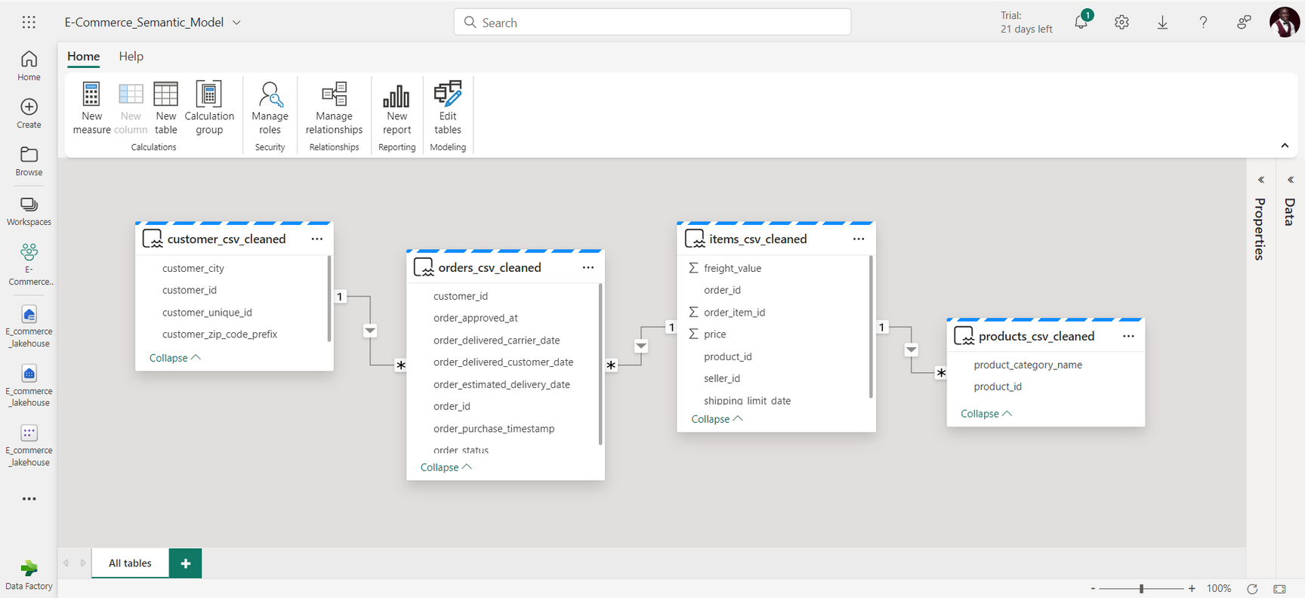
Semantic Model
18 of 28

Slide 20
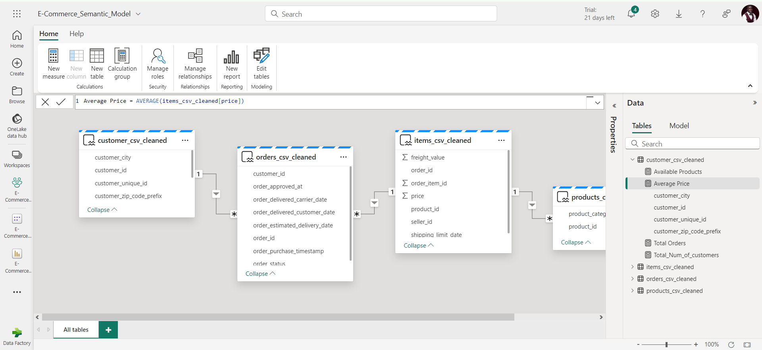
Data Analysis Expresions (DAX)
19 of 28

Slide 21
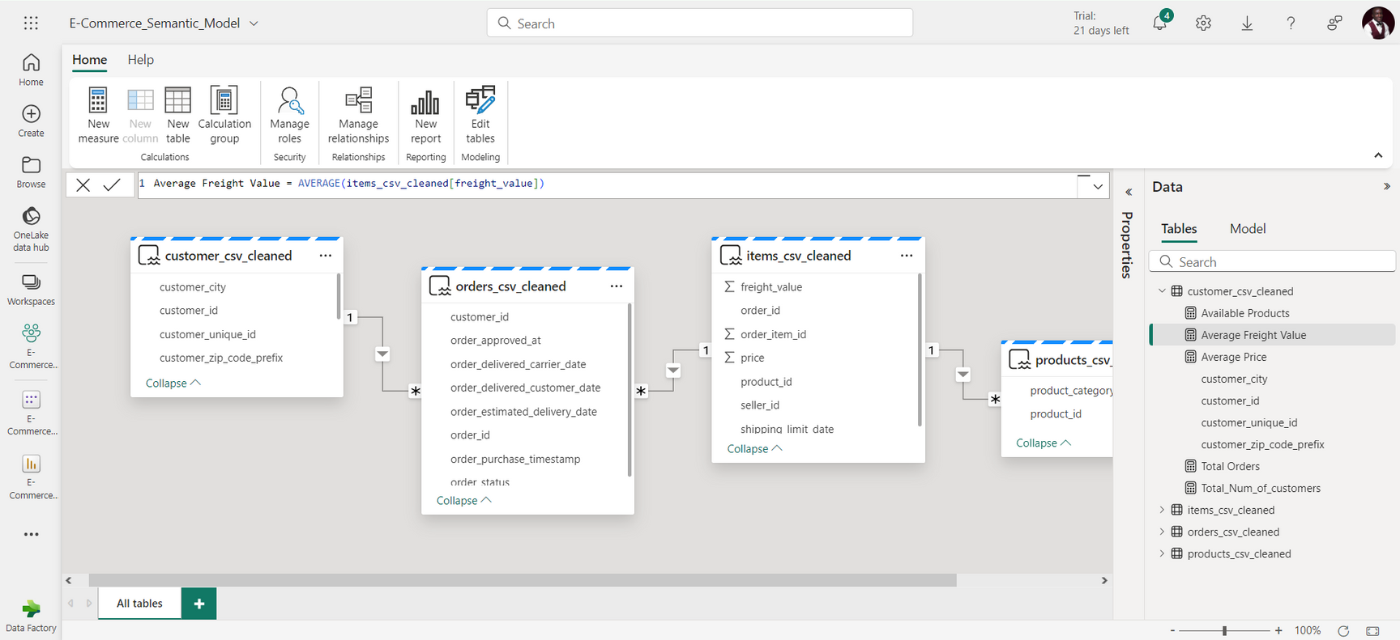
Data Analysis Expresions (DAX)
20 of 28

Slide 22
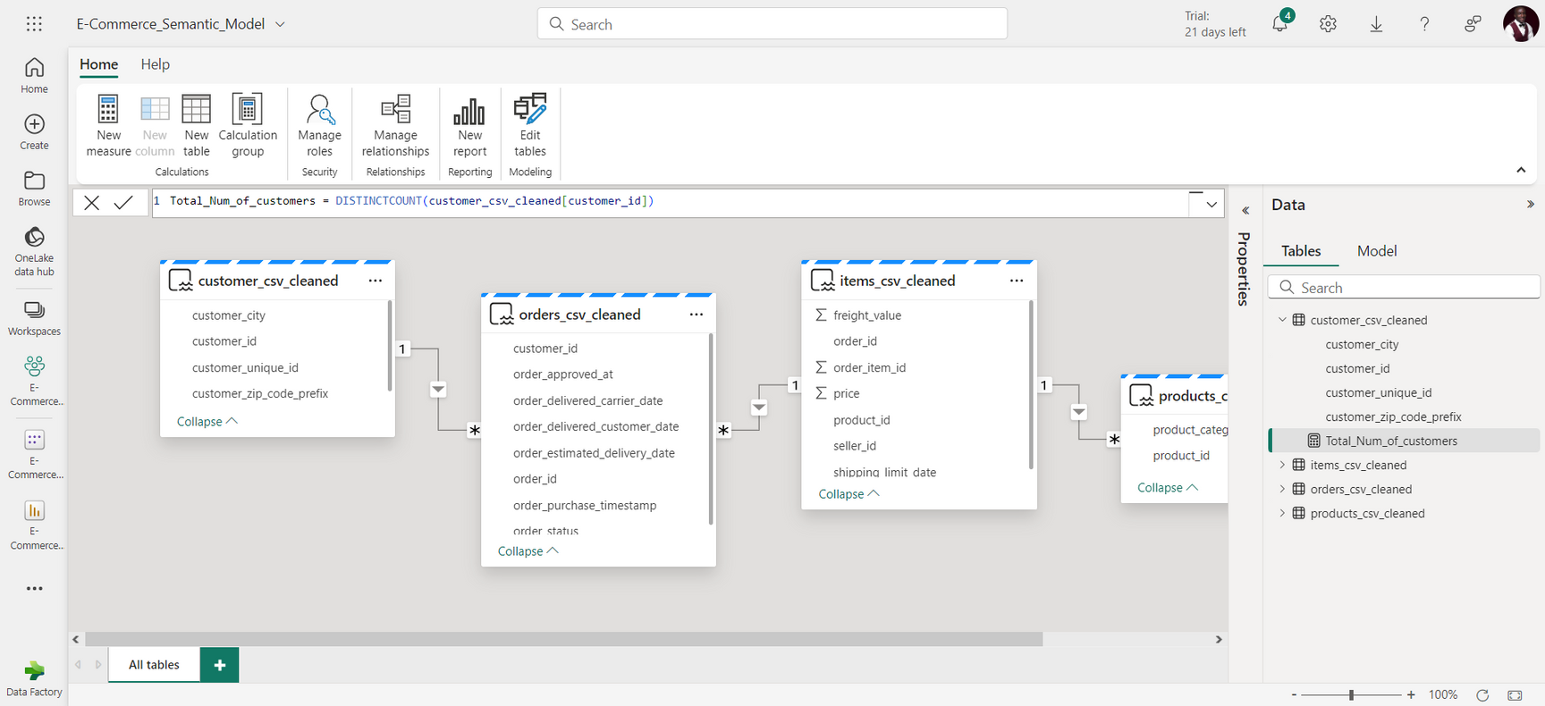
Data Analysis Expresions (DAX)
21 of 28

Slide 23
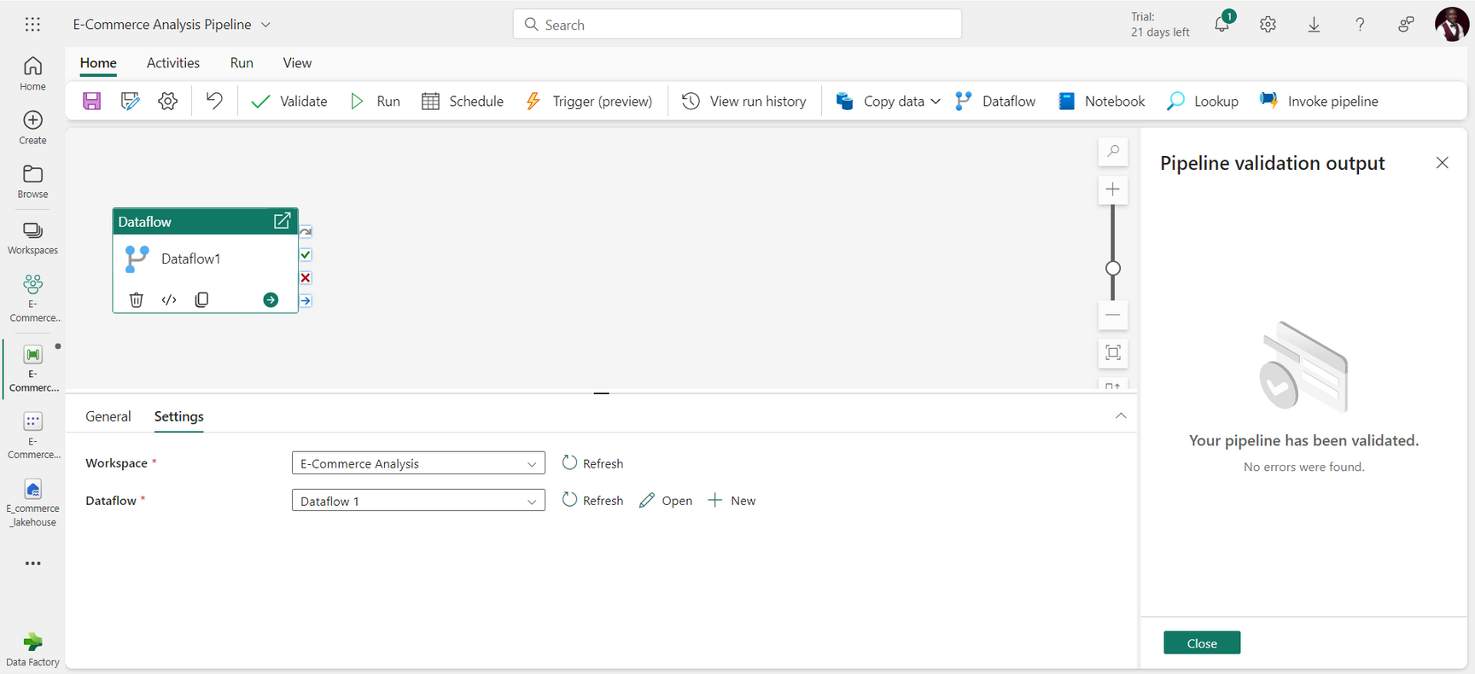
Pipeline Orchestration
22 of 28

Slide 24
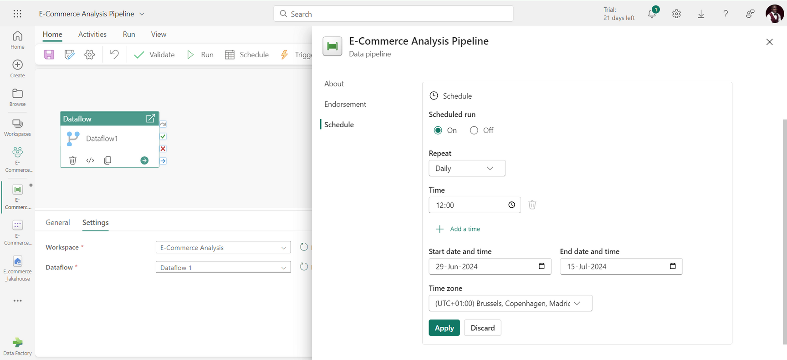
Pipeline Scheduling
23 of 28

Slide 25
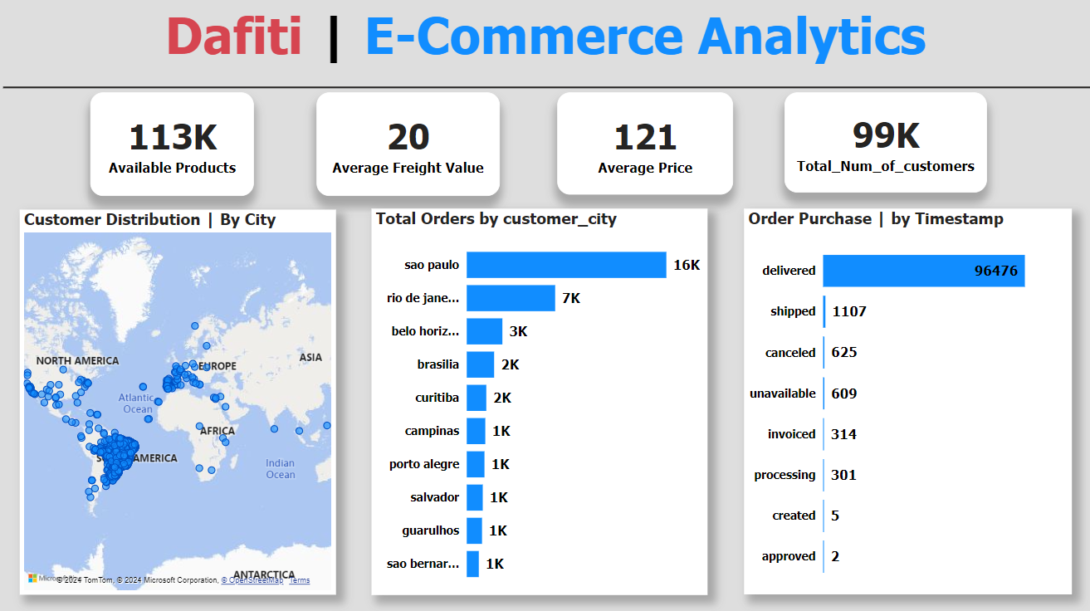


Result
24 of 28

Slide 26

Achievements
Becoming an advocate for data-driven decision-making.
Driving online sales through insights provided.
Increased possibility of future projects for Ultracode.
Improvement in my technical and soft skills.
25 of 28

Slide 27

Conclusion
This internship has significantly enriched my professional skill set, preparing me for future challenges and opportunities in the tech industry.
26 of 28

Slide 28


Future Prospects
Microsoft Fabric Analytics Engineer Certification.
Freelance roles and job opportunities.
“It is incredibly empowering to know that the future is in your hands.”
-Keanu Reeves
27 of 28

Slide 29

Thank You
For Your Attention
www.ultracodeltd.com.ng
28 of 28

